Slide 1
Mod 5
Mutiple access protocols

Slide 2
There are two types of network links: point-to-point links and broadcast links.
A point-to-point link consists of a single sender at one end of the link and a single receiver at the other end of the link.
Eg: link-layer protocols for point-to-point links; the point-to-point protocol (PPP) and high-level data link control (HDLC)
A broadcast link, can have multiple sending and receiving nodes all connected to the same, single, shared broadcast channel, The term broadcast is used because when any one node transmits a frame, the channel broadcasts the frame and each of the other nodes receives a copy. Eg: Ethernet and wireless LANs

Slide 3
Computer networks have protocols - so-called multiple access protocols - by which nodes regulate their transmission into the shared broadcast channel.
Multiple access protocols are required in a wide variety of network settings, including both wired and wireless local area networks, and satellite networks.
Because all nodes are capable of transmitting frames, more than two nodes can transmit frames at the same time. When this happens, all of the nodes receive multiple frames at the same time; that is, the transmitted frames collide at all of the receivers.
Normally, when there is a collision, none of the receiving nodes can make any sense of any of the frames that were transmitted; in a sense, the signals of the colliding frames become inextricably tangled together.

Slide 4
In this way, all the frames involved in the collision are lost, and the broadcast channel is wasted during the collision interval. Clearly, if many nodes want to transmit frames frequently, many transmissions will result in collisions, and much of the bandwidth of the broadcast channel will be wasted.
In order to ensure that the broadcast channel performs useful work when multiple nodes are active, it is necessary to somehow coordinate the transmissions of the active nodes. This coordination job is the responsibility of the multiple access protocol.

Slide 5
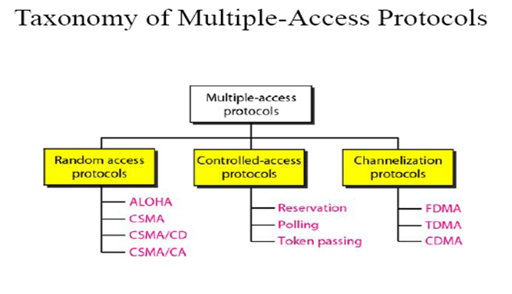

Slide 6
Random Access Protocols(Contention)
In random access or contention methods, no station is superior to another station and none is assigned the control over another.
At each instance, a station that has data to send uses a procedure defined by the protocol to make a decision on whether or not to send.(depends on the state of the medium)
There is no scheduled time for a station to transmit. Transmission is random among the stations (random access)
Second, no rules specify which station should send next. Stations compete with one another to access the medium. That is why these methods are also called contention methods.
In a random access method, each station has the right to the medium without being controlled by any other station. However, if more than one station tries to send, there is an access conflict—collision—and the frames will be either destroyed or modified

Slide 7
Random Access Protocols
Random access methods have evolved from a protocol called ALOHA which uses a simple procedure called Multiple Access(MA)
This method was improved with the addition of a procedure that forces a station to sense the medium before transmitting. This is called CSMA.
This method later evolved into two other methods CSMA/CA and CSMA/CD

Slide 8
ALOHA
Developed at the University of Hawaii for packet radio networks, applicable to any shared medium
Pure ALOHA-original ALOHA protocol
  Station can transmit frame at any time
  Then listens for an amount of time equal to the maximum possible round trip propagation delay
  Time =twice the time takes to send a frame between two most widely separated stations + a small fixed time increment
  If an ACK come during that time, OK, else resends the frame
  If a station fails to receive ACK after repeated transmissions, it gives up
  If two stations transmits at a time, collision
  If the received frame is invalid, simply ignores

Slide 9
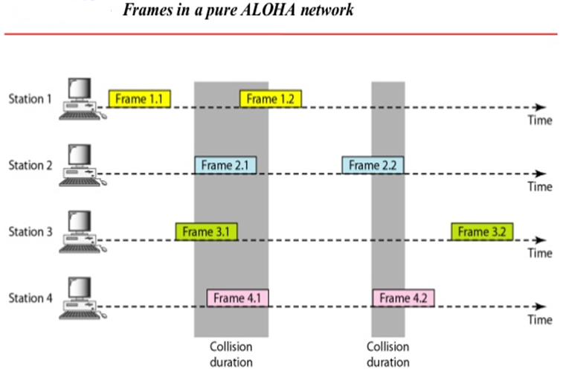

Slide 10
We need to resend the frames that has been destroyed during transmission .
The pure ALOHA relies on acknowledgements from the receiver.
After sending a frame the sender waits for acknowledgement and if it does not receive ,then after timeout period it resends the frame.
A collision involves two or more stations .If all these stations tries to resend their frames after the time out the frames will collide again.
Pure ALOHA dictates that when the time out period passes each station waits for random amount of time before resending the frame. The randomness avoids further collisions.

Slide 11
Slotted ALOHA
In Pure ALOHA there is no rule that defines when a station can send. A station may send soon after another station has started or soon after another station has finished.
Slotted ALOHA was invented to improve the efficiency of pure ALOHA.
In slotted ALOHA we divide the time into slots and force the station to send only at the beginning of the time slot.

Slide 12
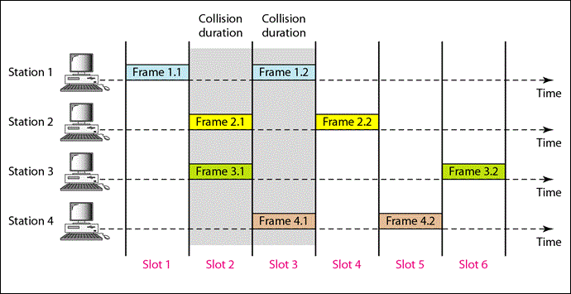

Slide 13
Because a station is allowed to send only at the beginning of a time slot , if a station misses this moment it should wait until the beginning of the next slot
But there is still a possibility of collision ,if two stations tries to send at the beginning of the same time slot.

Slide 14
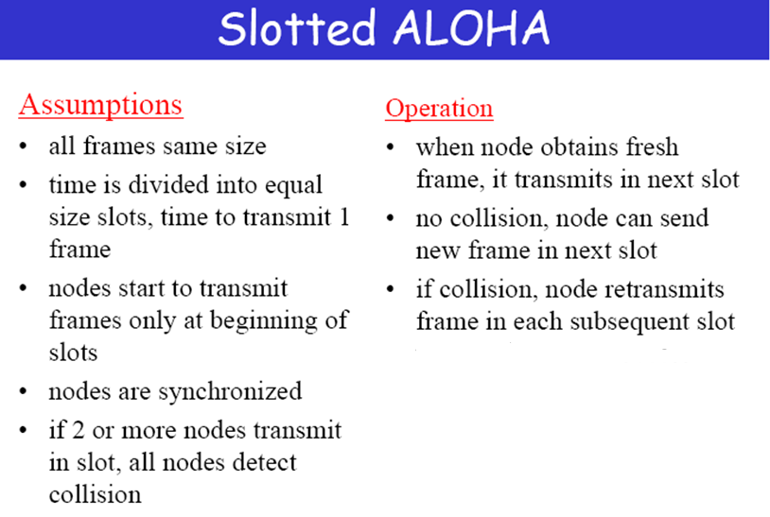

Slide 15
Slotted ALOHA
Time on the channel is organized into uniform slots
Size of slots is equal to the frame transmission time
Central clock is used for synchronize stations
Transmission is permitted to begin only at time slot boundary
Frames overlaps either totally or not.
Utilization increases to 37% than 18% of Pure ALOHA
Poor utilization of channel capacity in ALOHA methods.

Slide 16
Carrier Sense Multiple Access
A station wishing to transmit first listens the medium to determine another transmission is in progress.
This process is called carrier sense.
If the medium is in use, station will wait else station may transmit.
If more than one station attempt to transmit at about the same time, Collision.
After transmitting data, source station waits reasonable amount of time.
Waiting time will be maximum round-trip propagation delay + time required by destination station to get medium
If there is no Ack, collision hence retransmission
Maximum utilization can be much better than ALOHA

Slide 17
What happens if station finds the medium is busy
(1)Non persistent CSMA:
A station wishing to transmit listens to the medium and obeys the following rules
1. If the medium is idle, transmit else go to step 2
2. If the medium is busy , wait an amount of time and repeat step 1
(2) 1-Persistant CSMA:
A station wishing to transmit listens to the medium and obeys the following rules
1. If the medium is idle ,transmit else go to step 2
2. If the medium is busy , continue to listen until the channel is sensed idle, then transmit immediately

Slide 18
(3) P-persistent
This method is used when channel has time slots such that the time slot duration is equal to or greater than the maximum propagation delay time.
• Whenever a station becomes ready to send, it senses the channel.
• If channel is busy, station waits until next slot.
• If channel is idle, it transmits with a probability p.
• With the probability q=l-p, the station then waits for the beginning of the next time slot.
• If the next slot is also idle, it either transmits or waits again with probabilities p and q.
This process is repeated till either frame has been transmitted or another station has begun transmitting. In case of the transmission by another station, the station acts as though a collision has occurred and it waits a random amount of time and starts again.

Slide 19
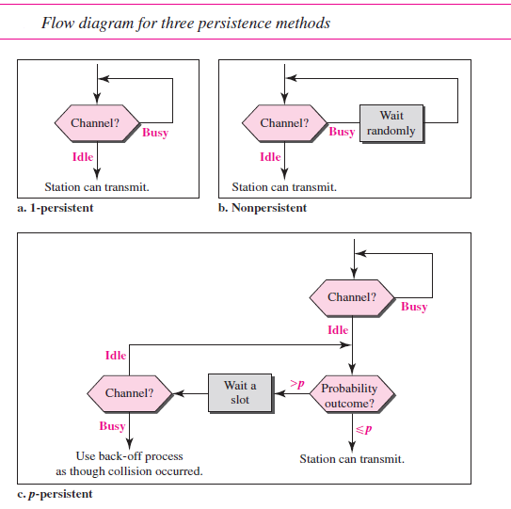

Slide 20
CSMA/CD
When two frames collide, the medium remains unstable for the duration of transmission of both damaged frames
Hence an alternate method, where
  A station continues to listen to the medium while transmitting
Rules of CSMA/CD
  If the medium is idle, transmit
  If the medium is busy, continue to listen until the channel is idle; then transmit immediately
  If a collision is detected during transmission, transmit a brief jamming signal to assure that all stations know that there is a collision and then cease transmission
  After transmitting jamming signal, wait a random amount of time, referred to as backoff then attempt to transmit again

Slide 21
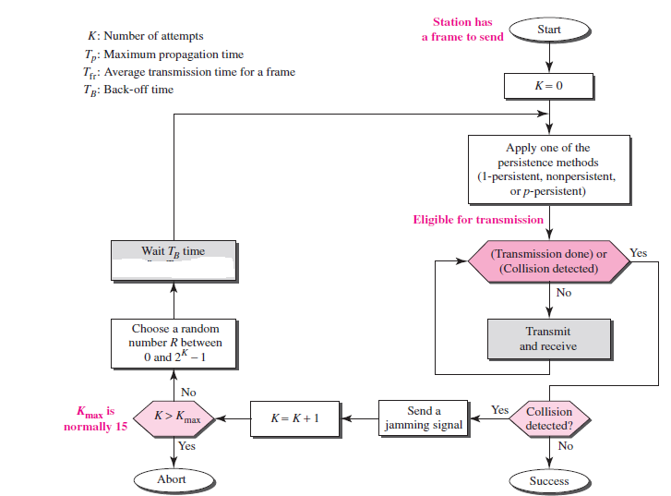

Slide 22
CSMA/CD
With CSMA/CD, the amount of wasted capacity is reduced into time it takes to detect a collision
This amount of time is not greater than twice the end-to-end propagation delay
Frames should be long enough to detect collisions prior to the end of transmission
If shorter frames are used, collision detection does not occur, hence same performance as CSMA
IEEE 802.3 LAN uses 1-Persistent CSMA with CD
Since non-persistence CSMA wastes time by waiting and p-persistence requires small value for p to avoid instability
Advantages to 1-Persistence is that, wasted time due to collision is shorter than waiting time
Two stations involved in a collision are unlikely to collide on their next tries, due to random backoff

Slide 23
Exponential Backoff
Backoff is the process by which a transmitting station determines how long to wait following a collision before attempting to retransmit the frame.
If all stations waited the same length of time before retransmission, then another collision would inevitably occur.
This is avoided by having each station generate a random number which determines the length of time it must wait before testing the carrier. This time period is known as the station's "backoff delay".

Slide 24
CSMA/CA
CSMA/CD is detecting collisions while transmitting data
Collisions can be detected with the help of energy of the signal
In wired network, energy of the signal is almost double when collision occurs, hence easy detection
But in wireless communication, energy level may not increase to a considerable level when collision occurs, hence less chance to detect collisions
Collision avoidance is better method than collision detection in these type of networks

Slide 25
Collisions are avoided through the use of CSMA/CA’s three strategies: the interframe space, the contention window, and acknowledgments.
Interframe Space (IFS)
First, collisions are avoided by deferring transmission even if the channel is found idle. When an idle channel is found, the station does not send immediately. It waits for a period of time called the interframe space or IFS.
Even though the channel may appear idle when it is sensed, a distant station may have already started transmitting.
The distant station’s signal has not yet reached this station. The IFS time allows the front of the transmitted signal by the distant station to reach this station. If after the IFS time the channel is still idle, the station can send.

Slide 26
Contention Window
The contention window is an amount of time divided into slots. A station that is ready to send chooses a random number of slots as its wait time.
It is set to one slot the first time and then doubles each time the station cannot detect an idle channel after the IFS time.
However, if the station finds the channel busy, it does not
restart the process; it just stops the timer and restarts it when the channel is sensed as idle. This gives priority to the station with the longest waiting time.
Acknowledgment
The positive acknowledgment guarantee that the receiver has received the frame.

Slide 27
Controlled Access
Stations consult one another to find which station has the right to send
A station cannot send unless it has been authorized by other stations
Three controlled access methods
  Reservation
  Polling
  Token Passing

Slide 28

1-Reservation access method
Stations take turns transmitting a single frame at a full rate ( R ) bps
Transmissions are organized into variable length cycles
Each cycle begins with a reservation interval that consists of (N) minislots. One minislot for each of the N stations
When a station needs to send a data frame, it makes a reservation in its own minislot.
By listening to the reservation interval, every station knows which stations will transfer frames, and in which order.
The stations that made reservations can send their data frames after the reservation frame.

Slide 29
Polling
It works with topologies in which one device is primary station and all other stations are secondary stations
All data exchanges must be made through primary station, even when ultimate destinations are secondary
Primary device controls the link, secondary device follows its instruction
Primary station determines which station can use the channel

Slide 30
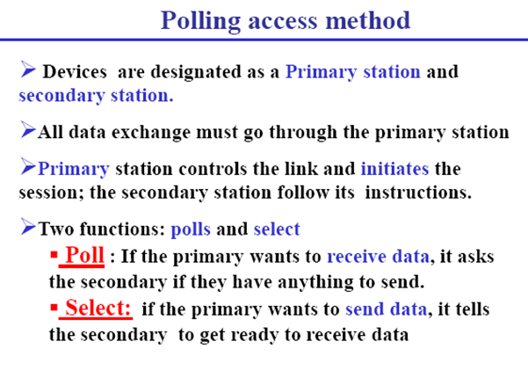

Slide 31
Polling
When primary want send or receive data, it uses Select function or Poll function
Select
  This function is used when primary device want to send data
  If the primary is neither sending nor receiving data, medium is available. Since all data transmissions happens through primary
  Primary alerts desired secondary by sending select(SEL) frame
  It waits for acknowledgment before sending data

Slide 32
Polling
Poll
  It is the process in which the primary stations asks secondary station, whether they want to send data
  Primary Polls all secondary stations in turn
  If the secondary want to send data, it responds with data frame
  Otherwise responds with NAK frame
  When data is received from secondary, it responds with ACK frame

Slide 33

SELECT and POLL functions

Slide 34
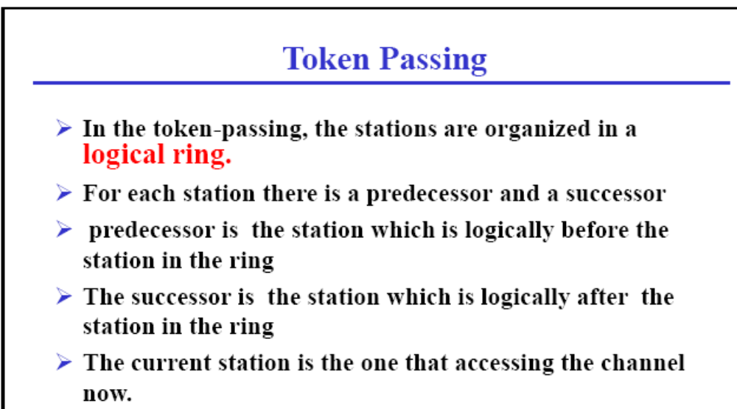

Slide 35
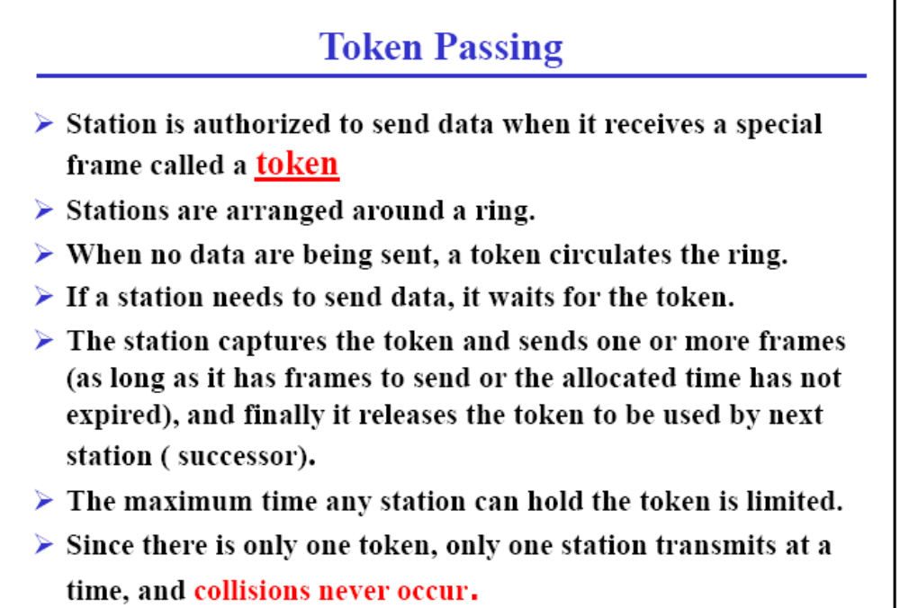

Slide 36
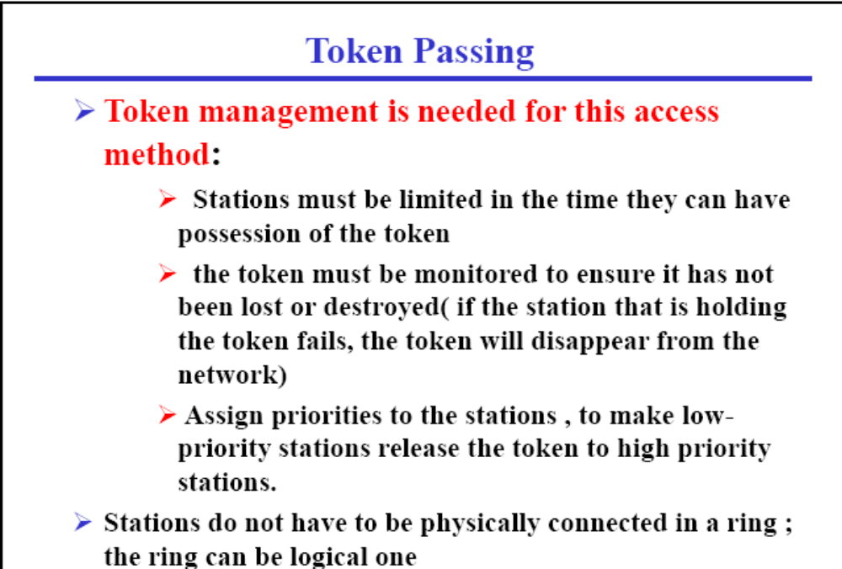

Slide 37
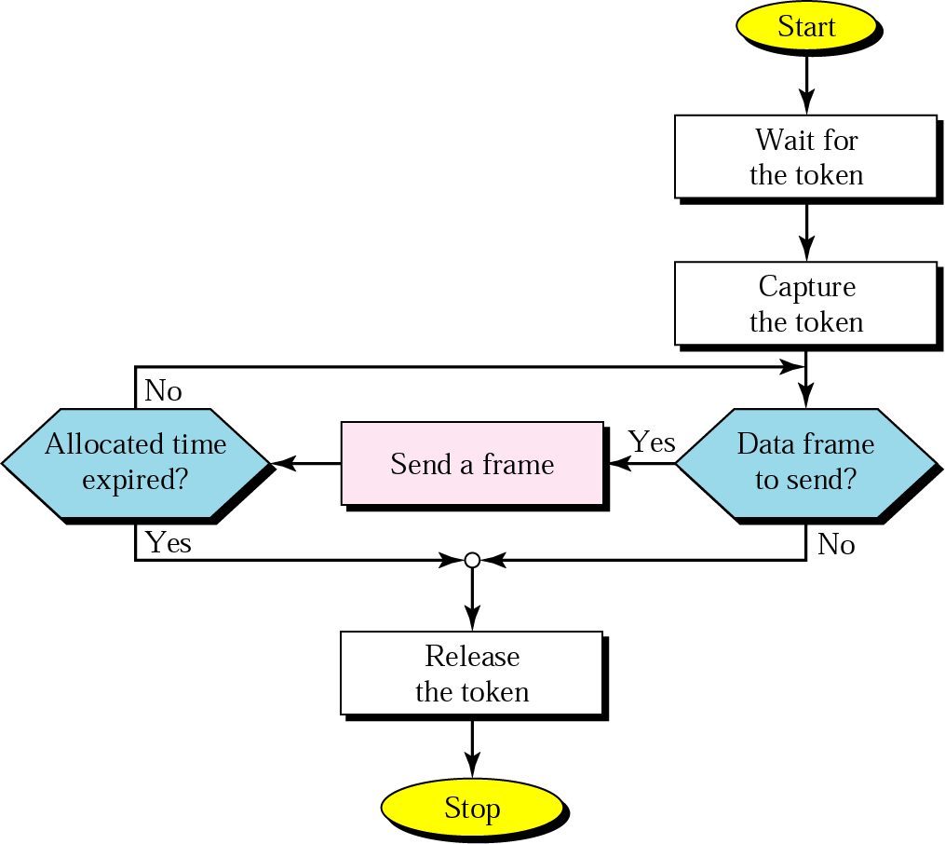
Token-passing procedure

